Slide 1
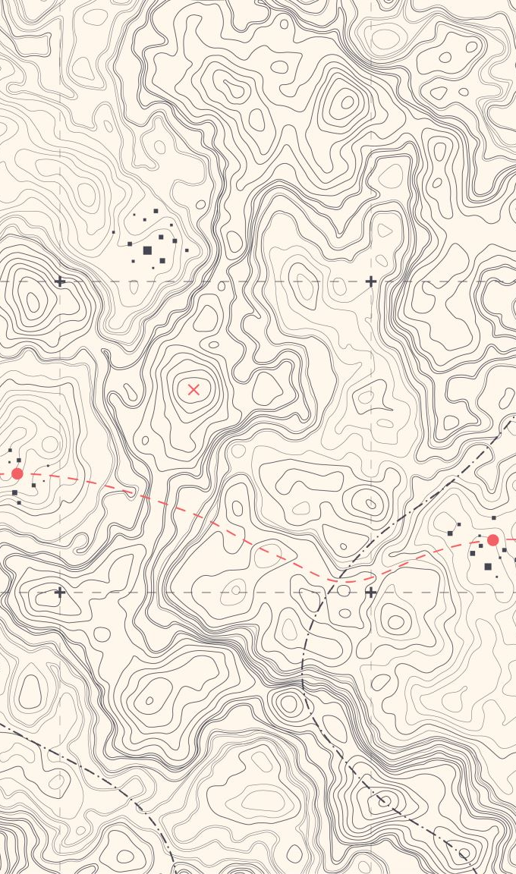
Big Mountain Resort Ticket Pricing Strategy
Executive Summary & Recommendations
Vladimir Sofiyev, Ph.D.
March 10, 2026

Slide 2
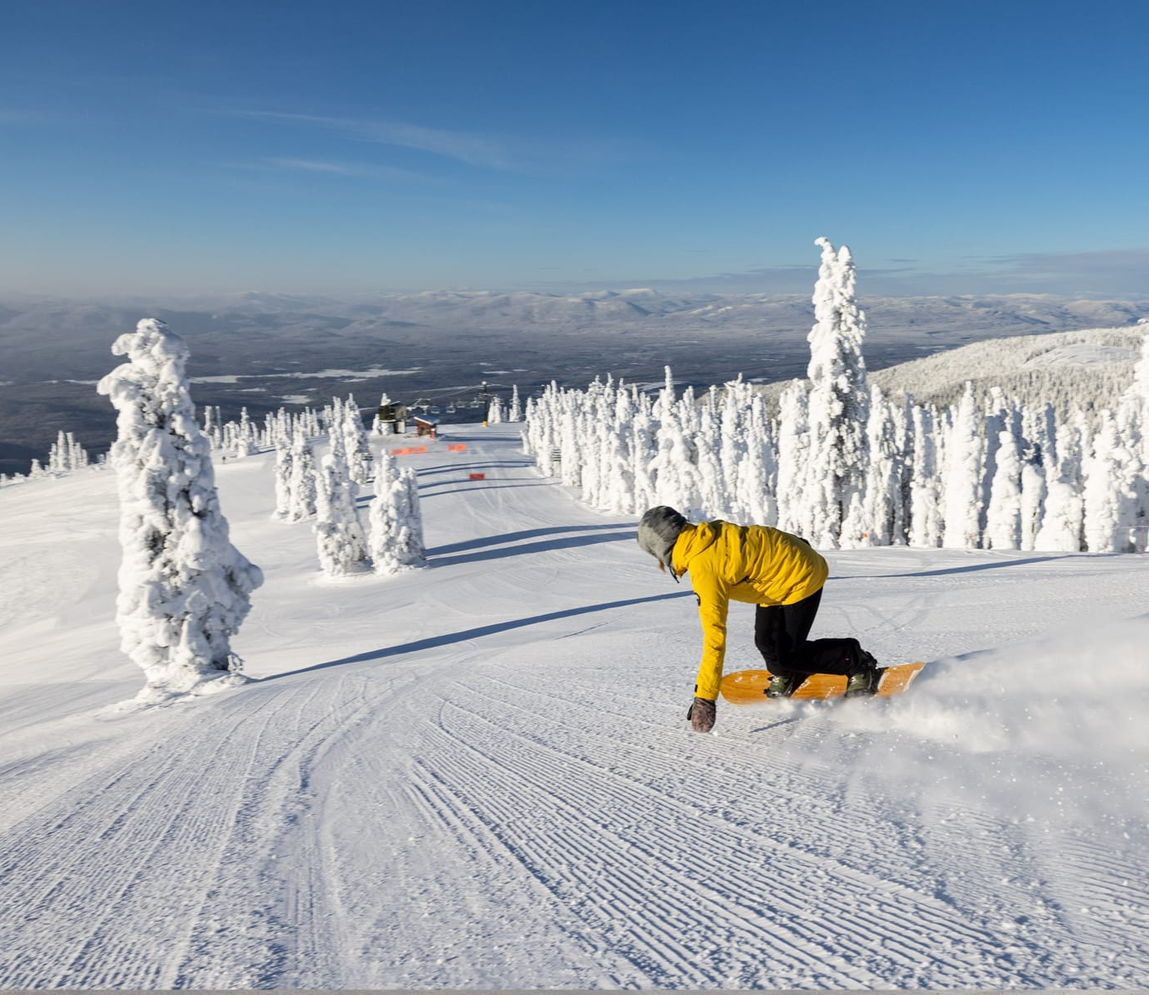
Business Context
Installation of an additional chair increased annual operating costs by $1.54M
Objective: Determine optimal lift ticket pricing to maintain competitiveness and profitability
Analysis based on competitive market positioning and data-driven modeling starting from a database of all US resorts

Slide 3
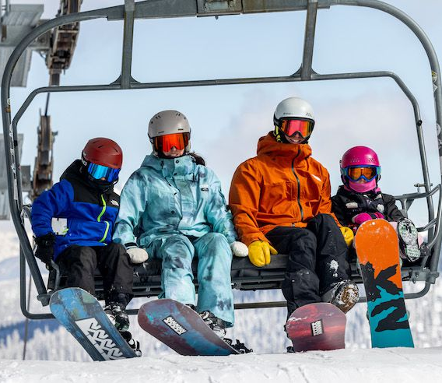
Primary Recommendation
Increase lift ticket prices to at least $94 per person
Aligns Big Mountain Resort with average pricing in its market segment
Expected to generate approximately $22.75M in additional annual revenue (compared to $81 tickets)
Assumes ~350K visitors purchasing ~5 lift tickets each

Slide 4
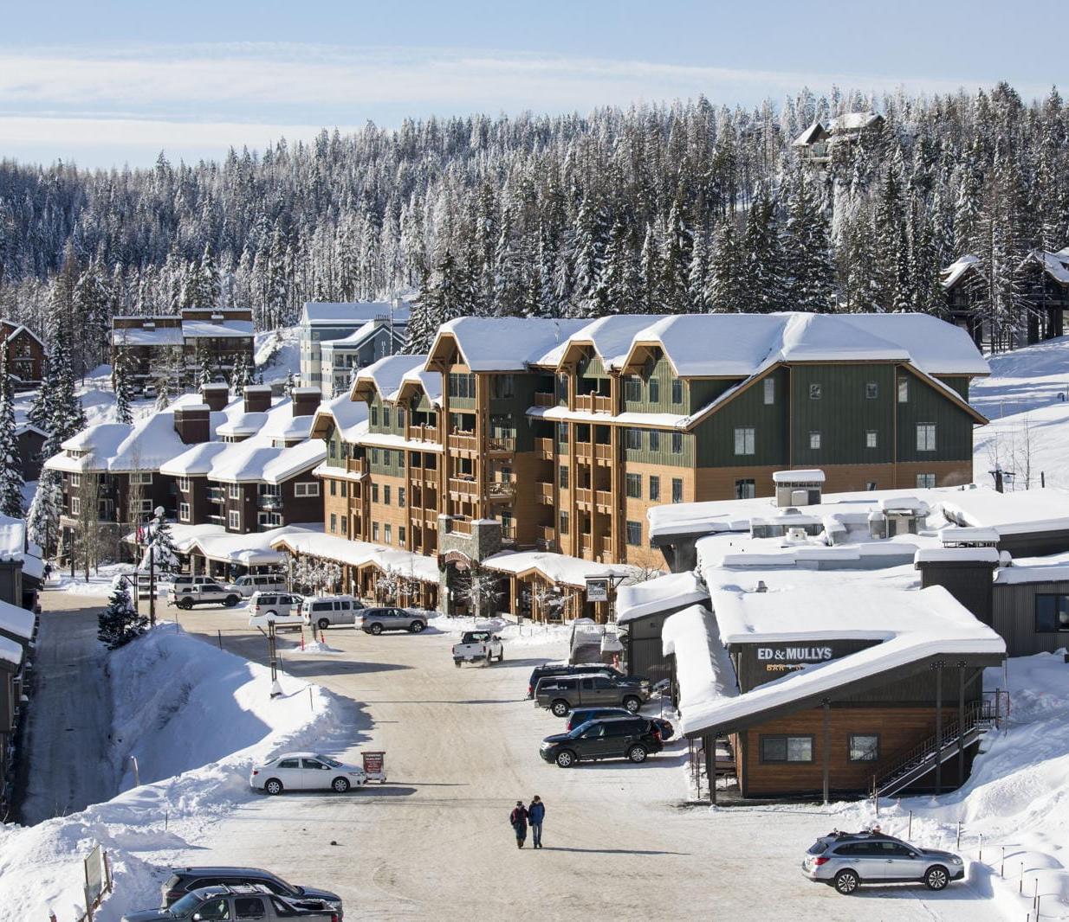
Expansion Scenario: Increased Vertical Drop
Scenario includes adding a run 150 feet lower with an additional chair lift
No additional snowmaking coverage required
Supports an additional ticket price increase to $95 per person
Estimated incremental revenue: $1.95M annually

Slide 5
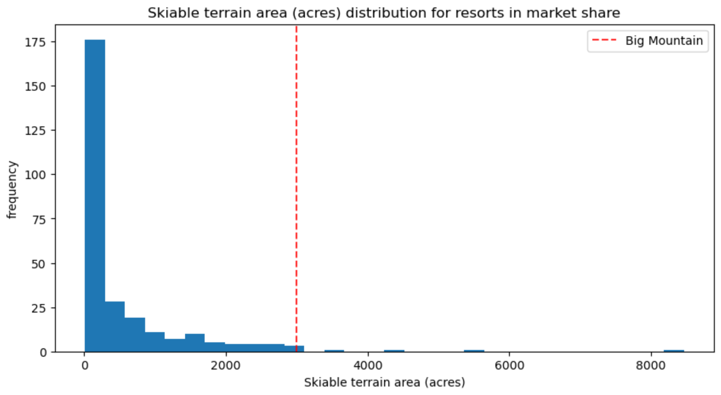
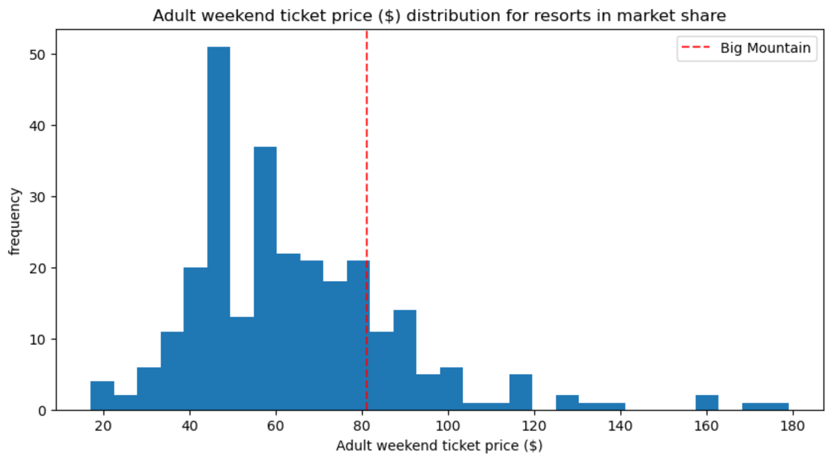
Analytical Approach
Comprehensive U.S. ski resort dataset cleaned and analyzed
Exploratory data analysis identified key drivers of ticket prices
Machine learning models built using Python and scikit-learn
Random forest models provided the most consistent predictions

Slide 6
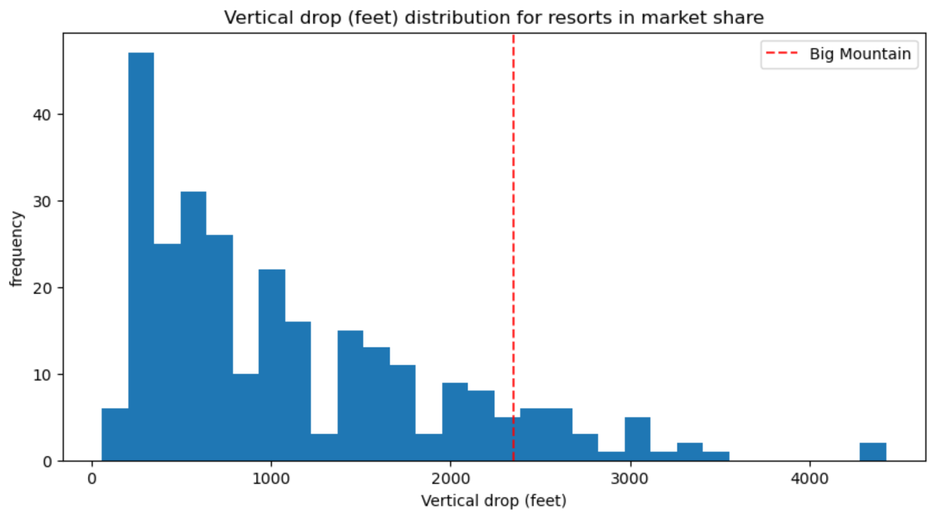
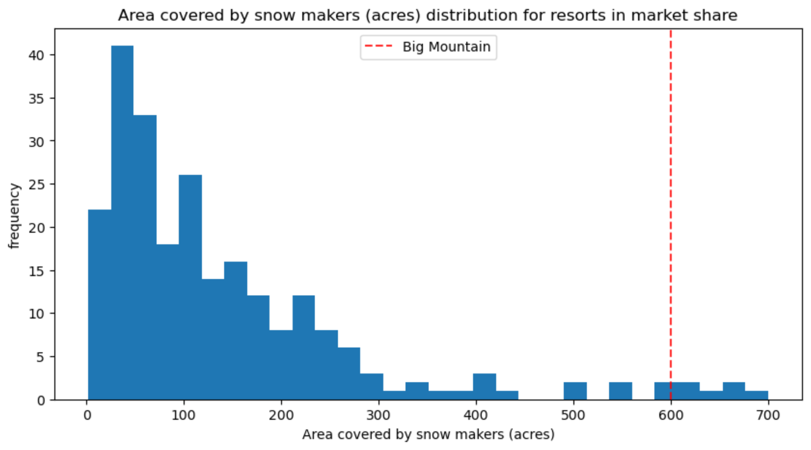
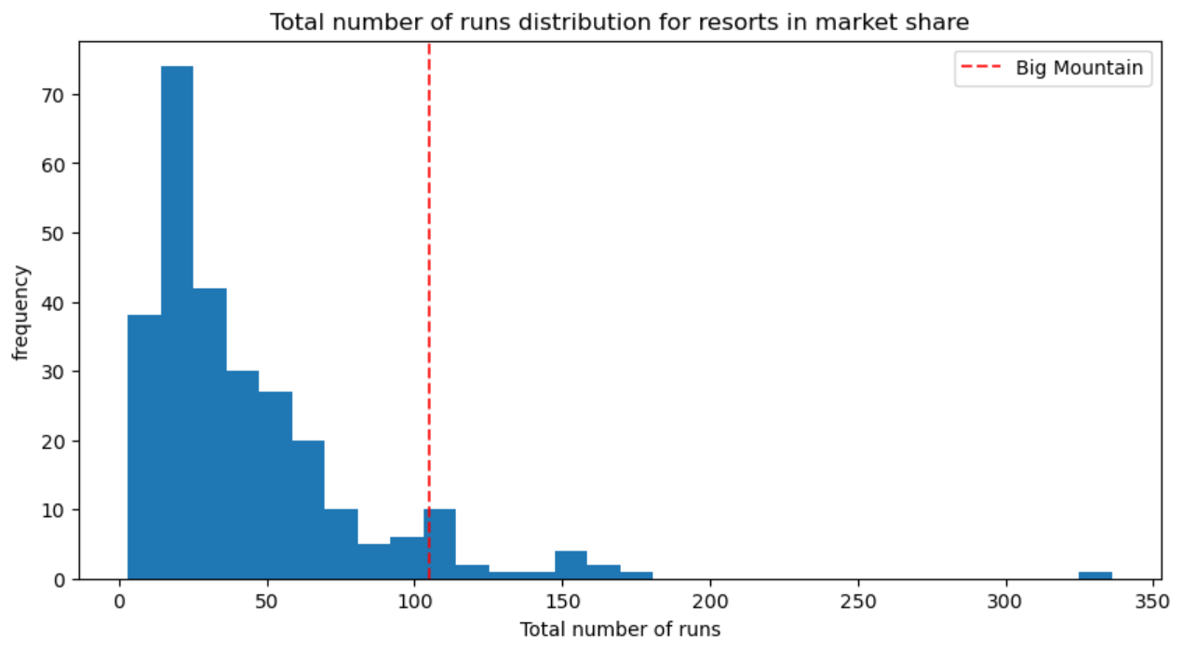
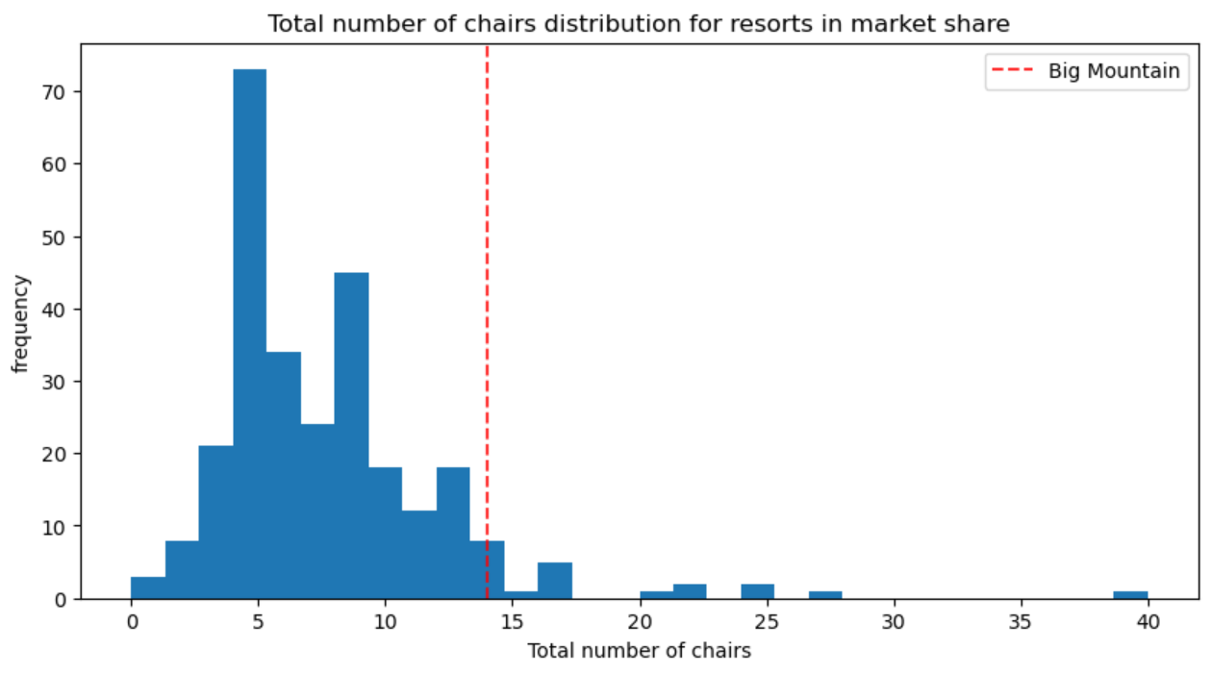
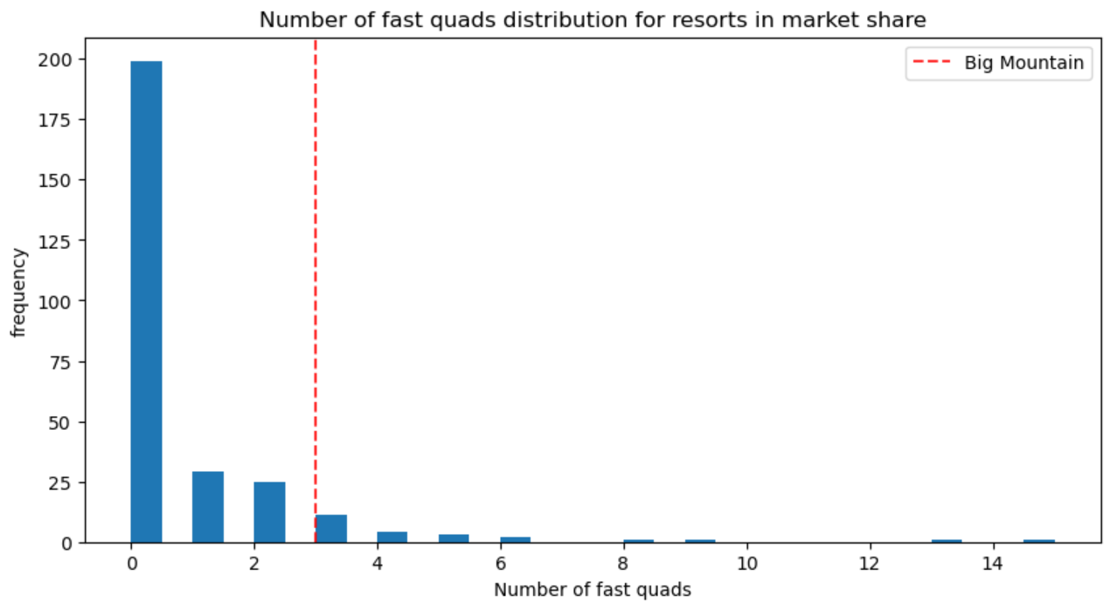
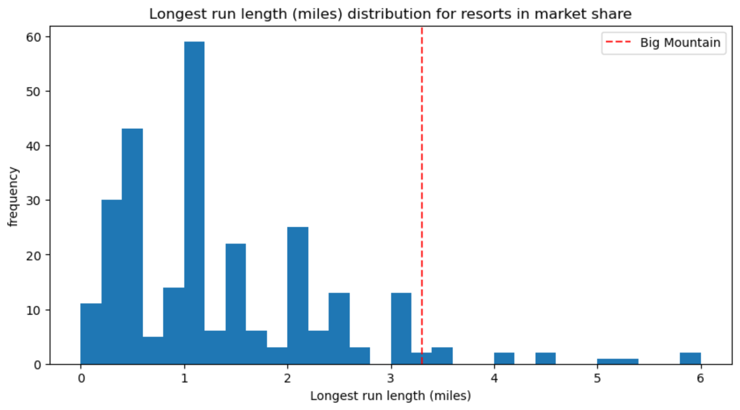
Key Drivers of Ticket Prices
Skiable terrain size, maximum vertical drop and longest run length
Snowmaking coverage area, and days open per year
Number of runs, lifts, and fast quad chairs

Slide 7
Future Opportunities
Incorporate annual visitor volume and demand elasticity
Introduce dynamic pricing by season, holidays, and snow conditions
Evaluate value of uncrowded experience versus travel inconvenience
Enhance revenue through experience-focused investments

Slide 8
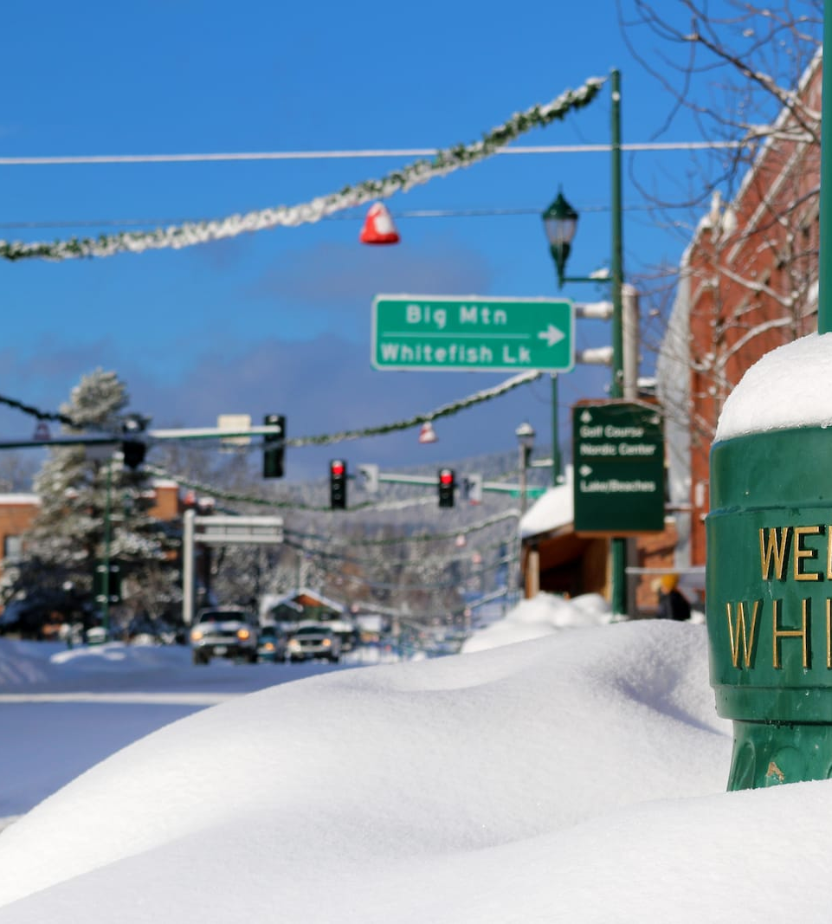
Summary and Premium Pricing Opportunity
Primary recommendation to increase lift ticket prices to at least $94 per person
Addition of a 150 ft run and a chair lift - $95 per person
Focused analysis of comparable U.S. resorts suggests pricing potential of $100–$105
Position Big Mountain Resort as a premium offering
Justified by outstanding terrain and top facilities
Represents upside beyond average market pricing

Slide 9
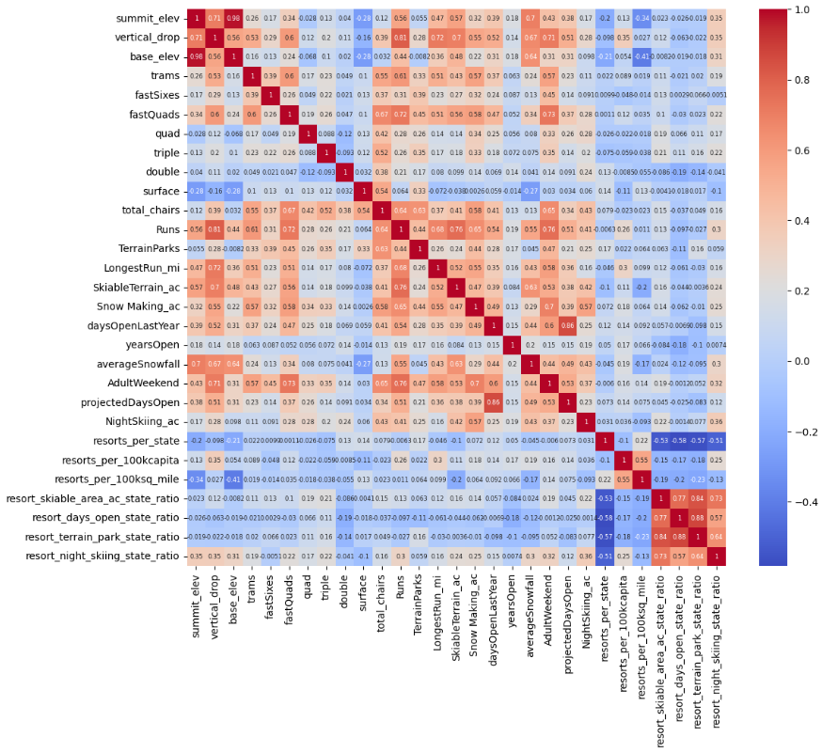
Appendix: heatmap of correlations in the ski data for the US resorts

